Slide 1





Senior Lesson
Eczema

Slide 2
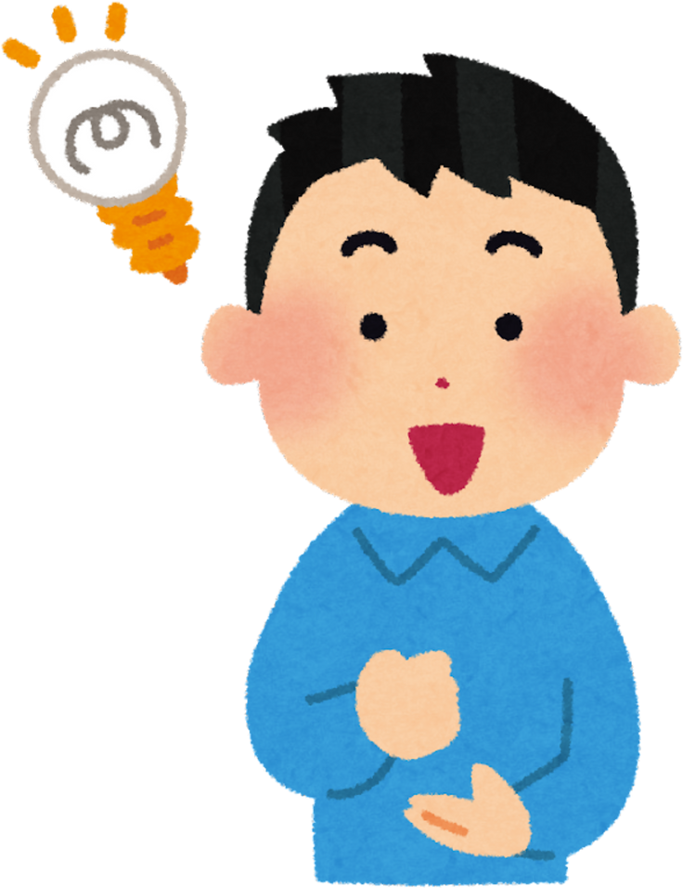
Who remembers what eczema is?

Slide 3
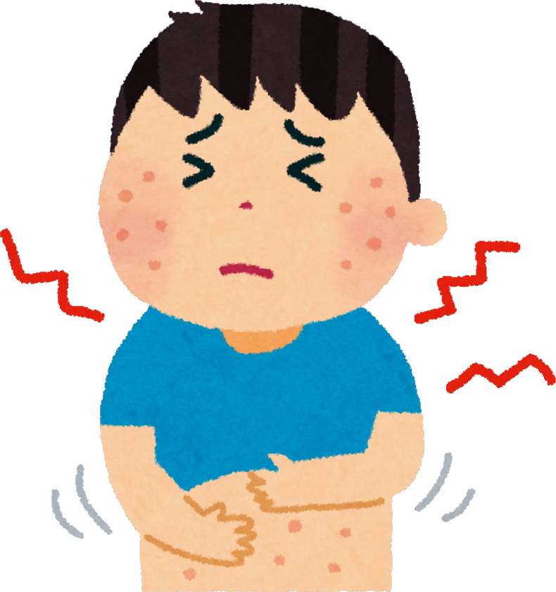
Eczema is a skin condition that makes the skin dry, itchy, and sore

Slide 4
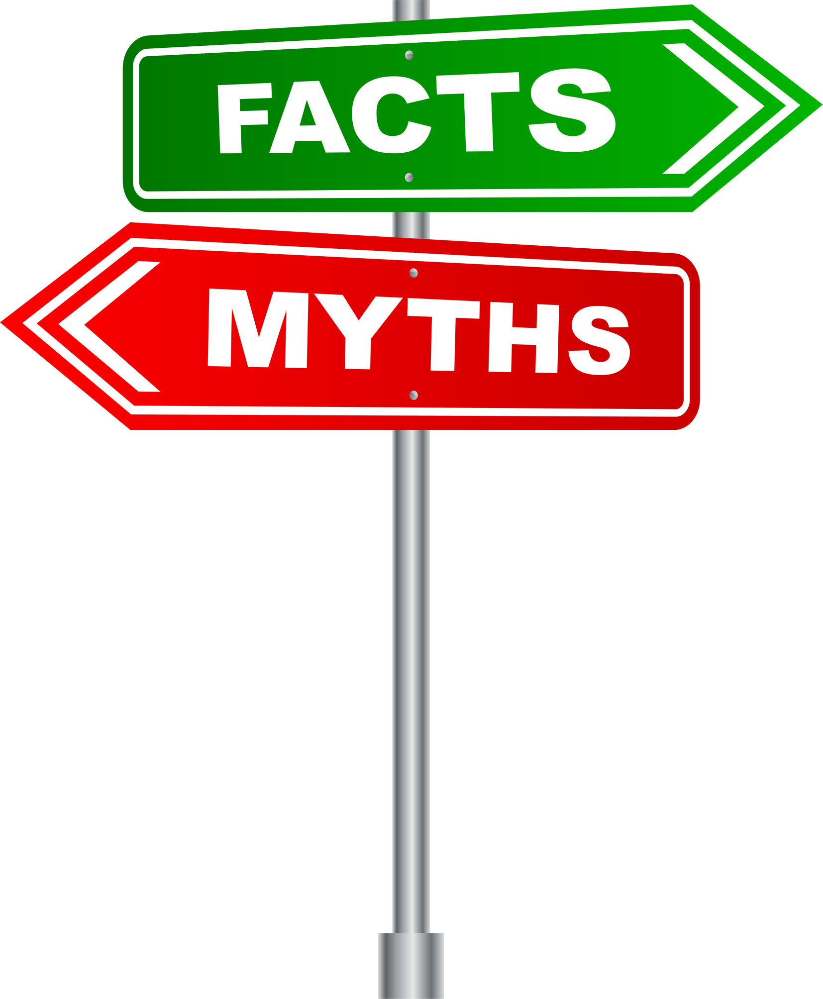
Myths & Facts Activity

Slide 5

What were the myths?

Slide 6
The skin is the smallest organ in the body

Slide 7

It is the largest organ in the body

Slide 8
You can catch eczema from holding hands with someone who has it

Slide 9
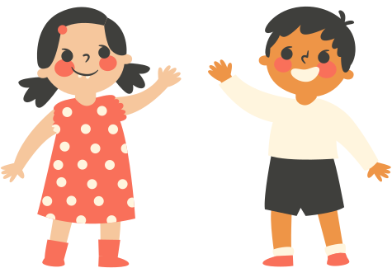
You can’t catch eczema

Slide 10
Using creams from the doctor will cure eczema

Slide 11

You can’t cure eczema but using creams every day can make it feel better

Slide 12
Eczema looks the same on everyone’s skin

Slide 13

Eczema looks different on different skin tones

Slide 14
Only children get eczema

Slide 15
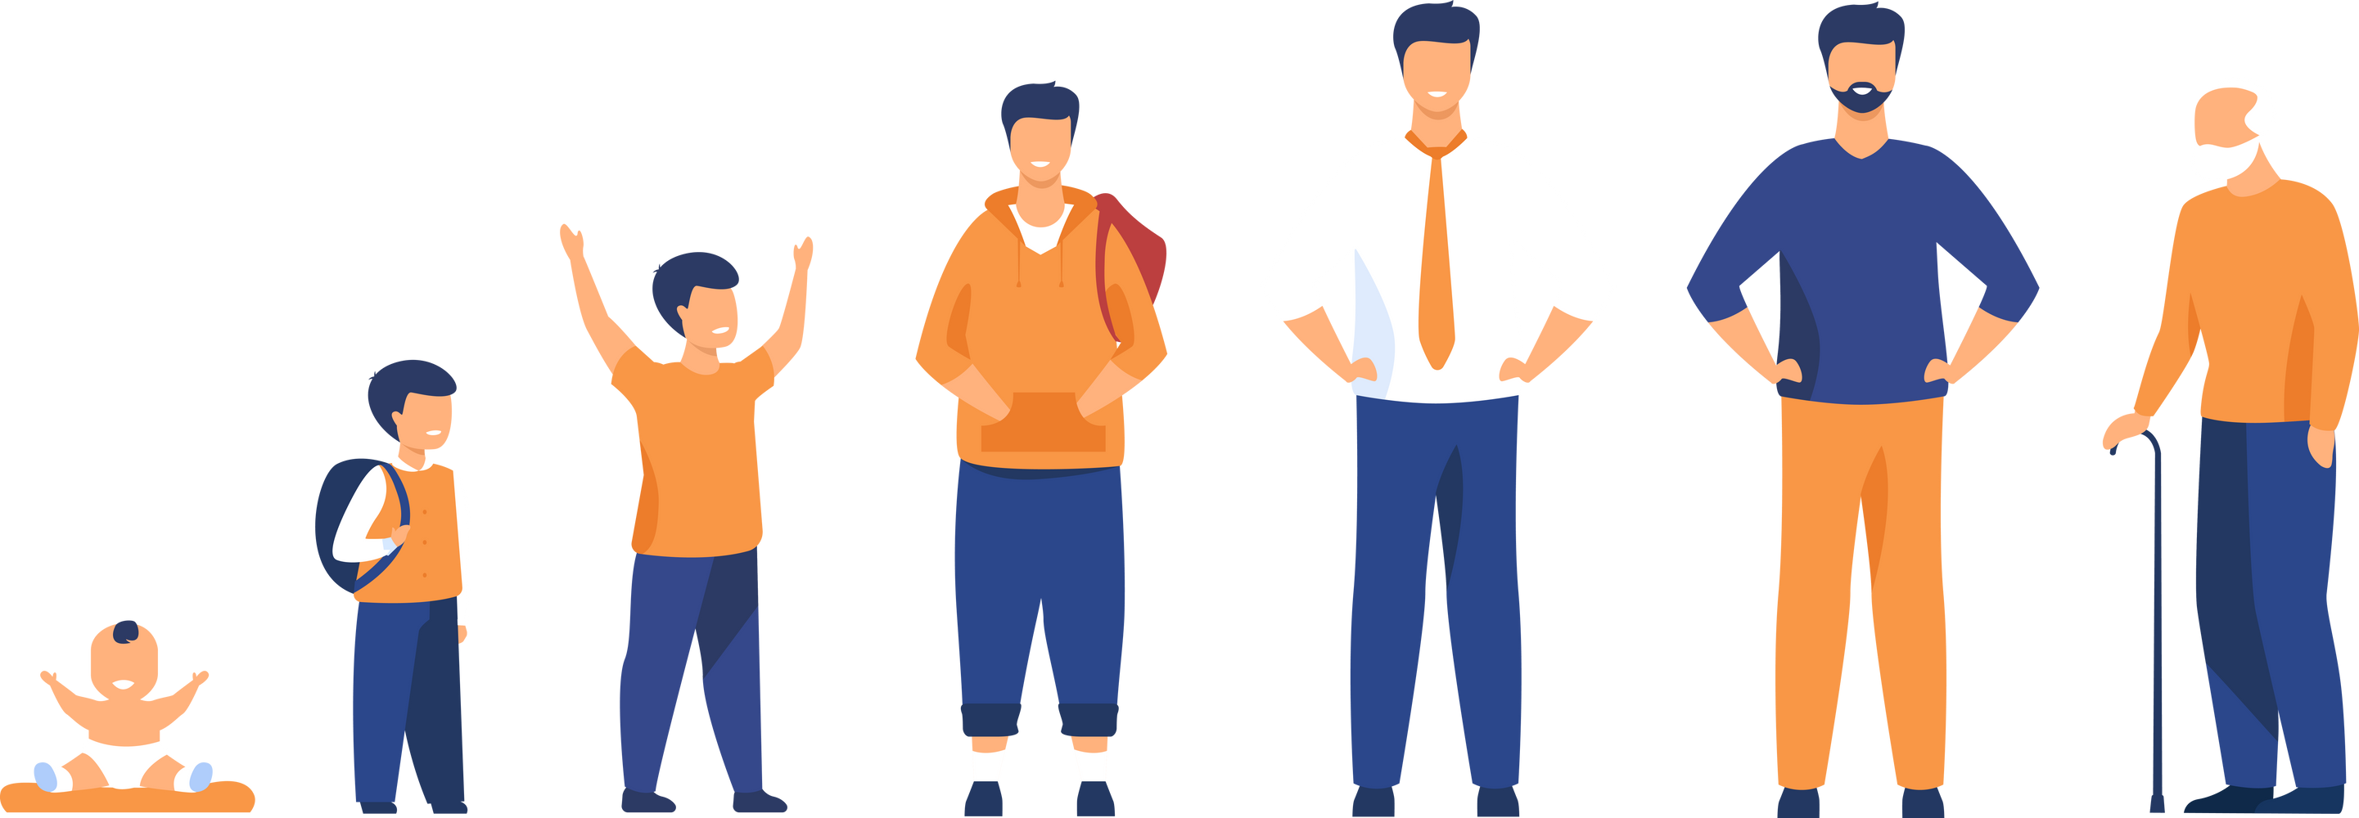
Anyone can get eczema

Slide 16

What were the facts?

Slide 17
When people have eczema, the top layer of their skin lets water escape

Slide 18
2.5 million people in the UK have eczema

Slide 19
Eczema can make it hard to concentrate at school

Slide 20
Itchy eczema can make it hard to sleep

Slide 21
Triggers are things that can make eczema worse (flare up)

Slide 22
Making an Eczema Friendly Classroom

Slide 23
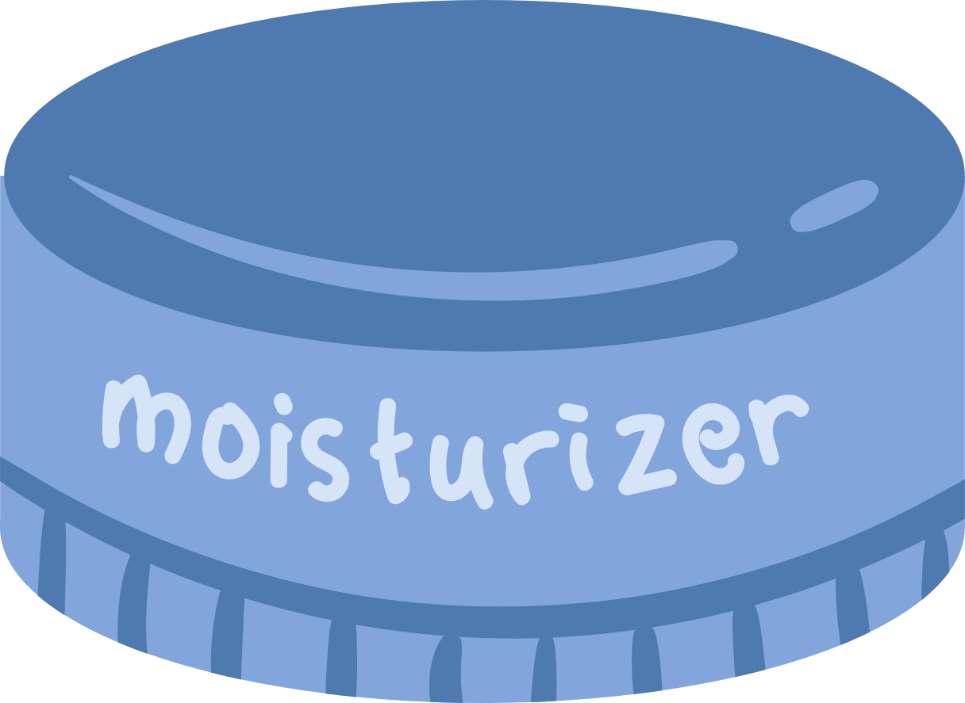
Creams & Emollients

Slide 24
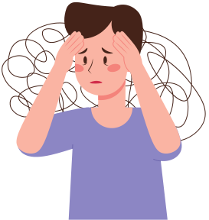
Hard to concentrate

Slide 25

Cool Pack

Slide 26
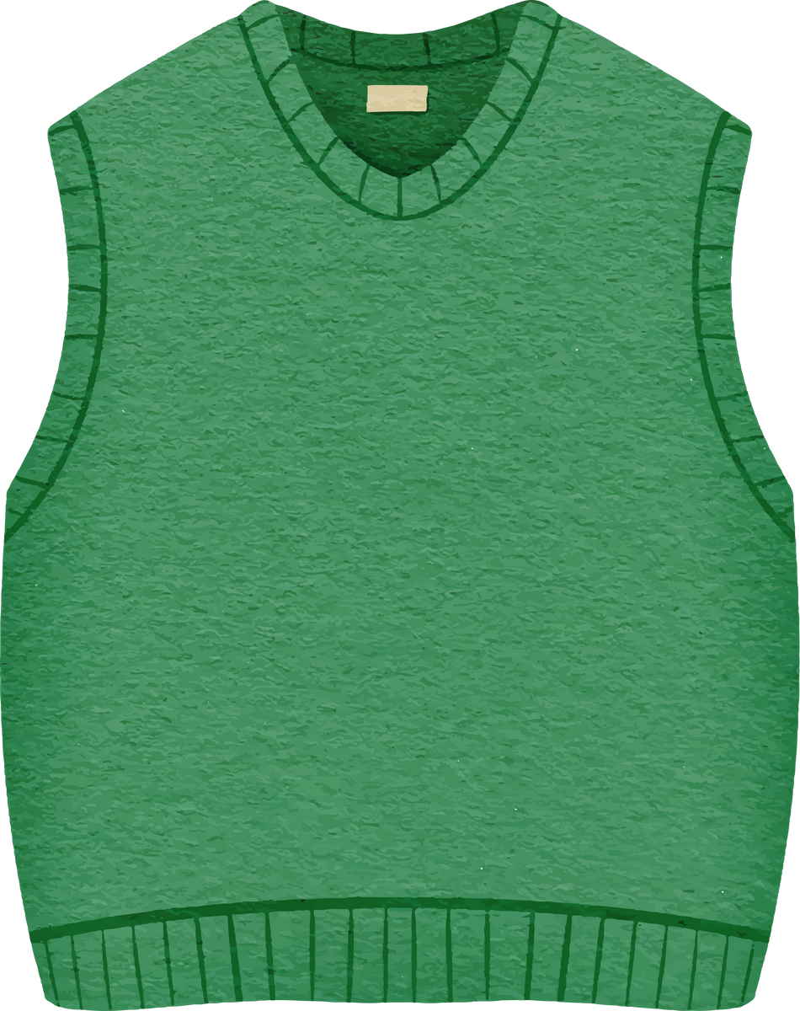
Certain fabrics

Slide 27
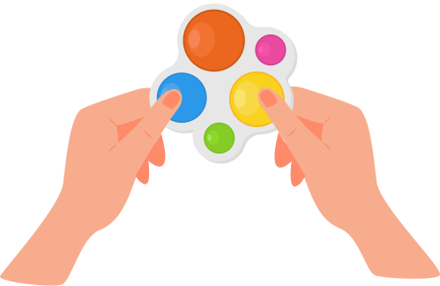

Fidget Toys

Slide 28

Sitting on a Mat

Slide 29
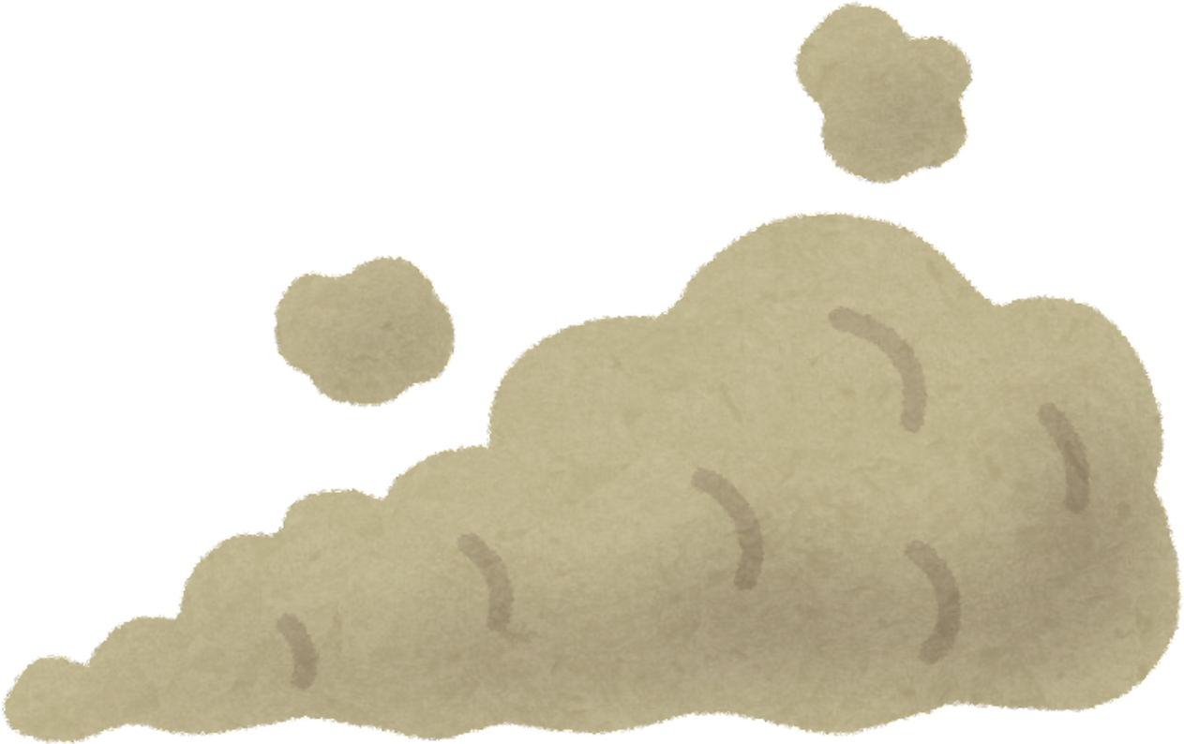
Dust

Slide 30

A Later Start Time

Slide 31


Special Soaps

Slide 32
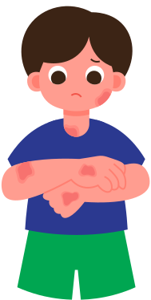
Self-conscious

Slide 33

Feeling Tired & Grumpy

Slide 34


Hot or Cold Temperatures

Slide 35
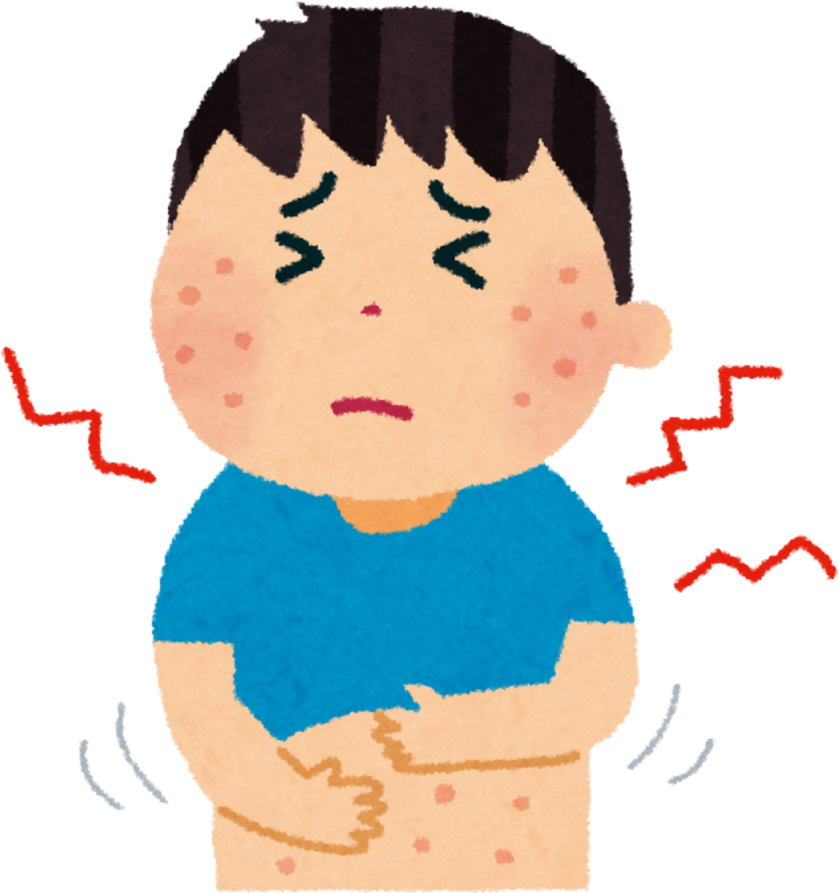
Itchy & Sore Skin

Slide 36

Pollen

Slide 37
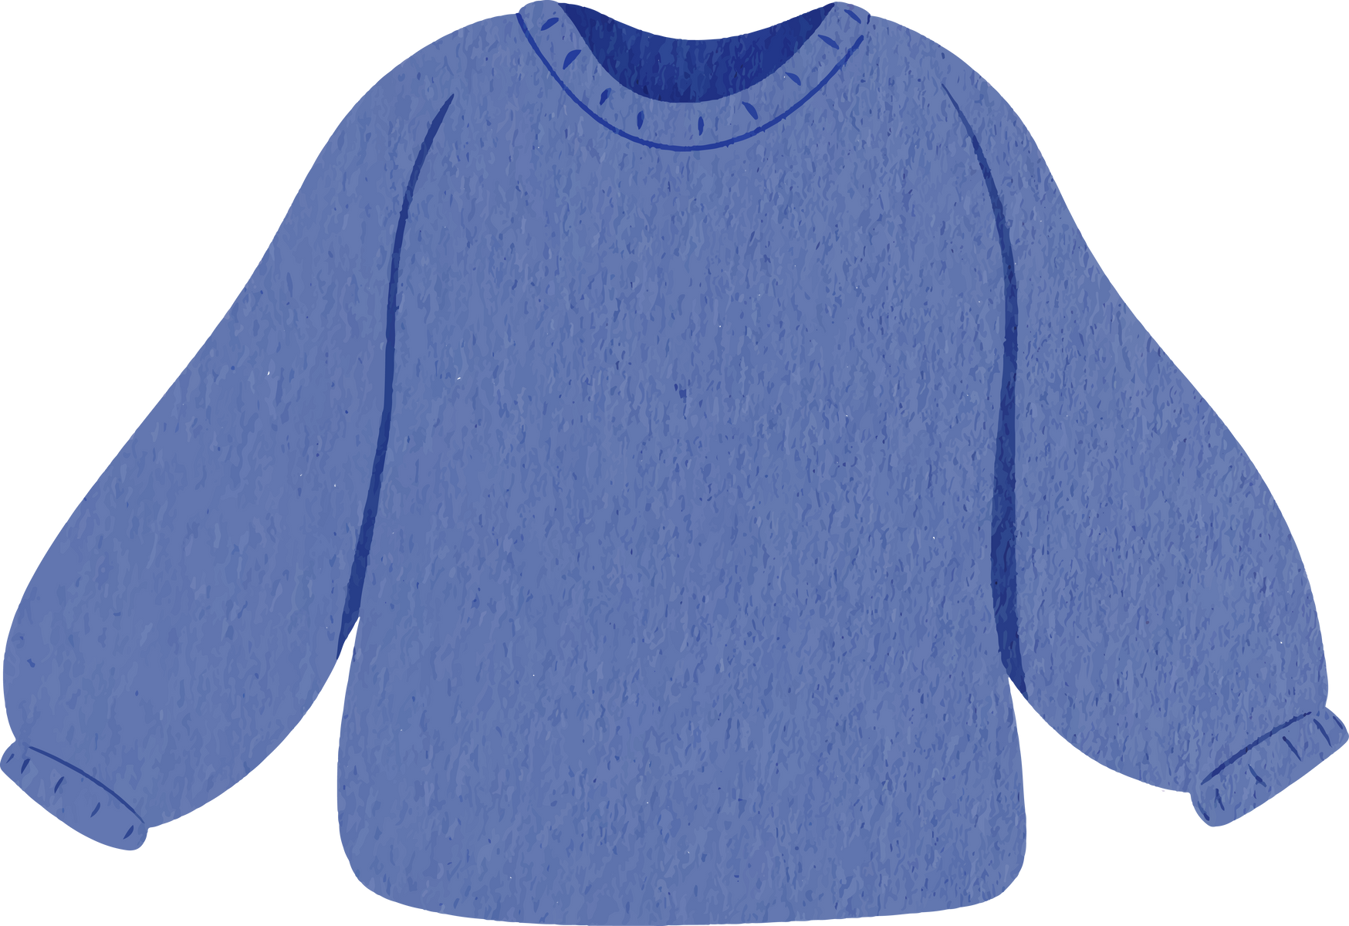
Comfortable Clothing

Slide 38
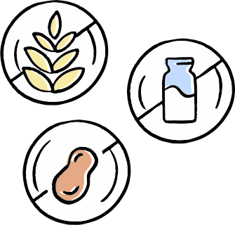
Certain Foods

