Slide 1





Junior Lesson
Eczema

Slide 2
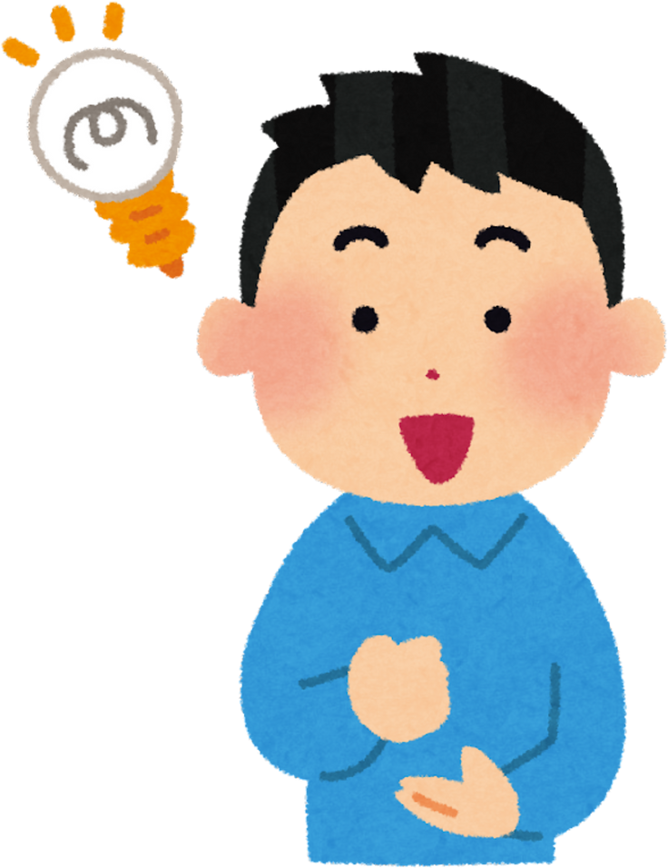
Who remembers what eczema is?

Slide 3
Eczema is a skin condition that makes the skin dry, itchy, and sore

Slide 4


Thumbs Up, Thumbs Down
If you think the sentence is true put your thumbs up
If you think the sentence is false put your thumbs down

Slide 5

The skin is the smallest organ in the body

Slide 6
False

Slide 7
It is the biggest organ in the body

Slide 8
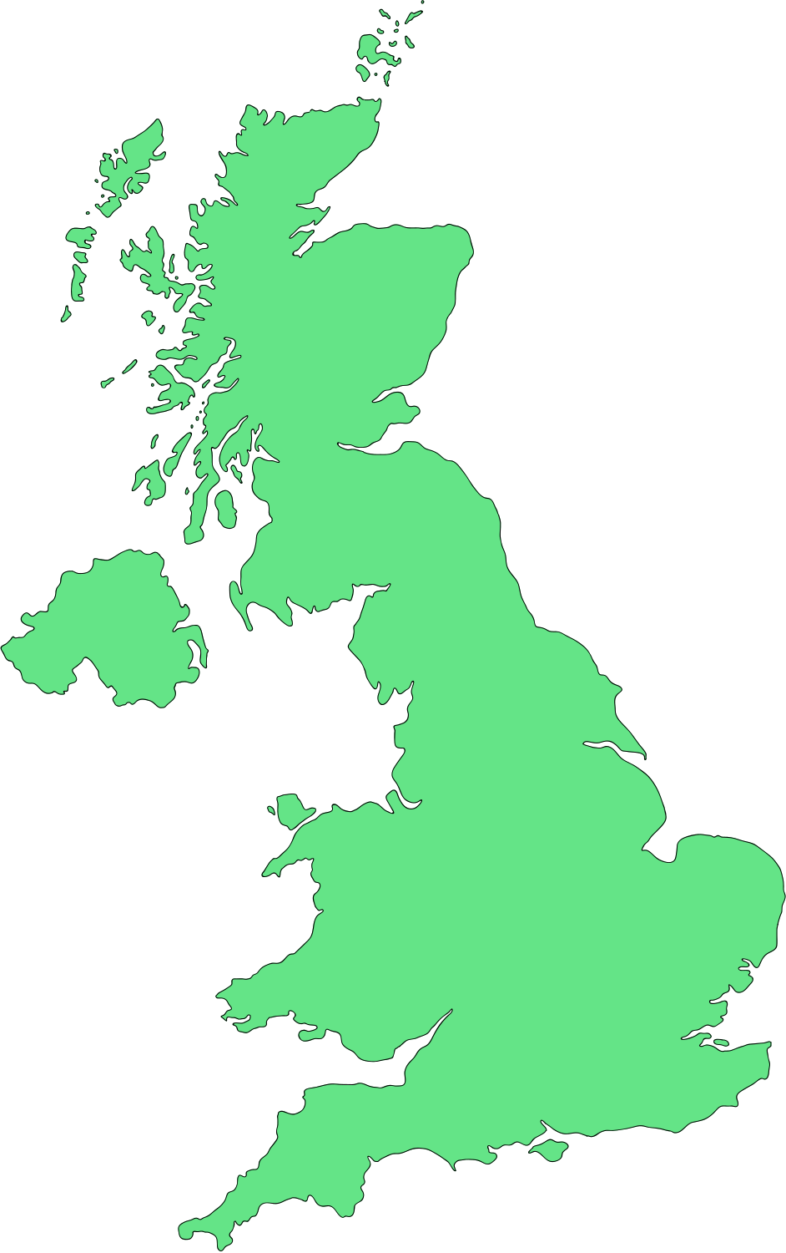
2.5 million people in the UK have eczema

Slide 9
True

Slide 10
Lots of people have eczema

Slide 11
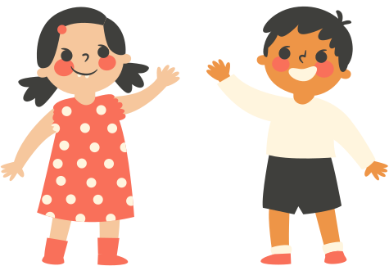
You can catch eczema from someone who has it

Slide 12
False

Slide 13
You can’t catch eczema

Slide 14
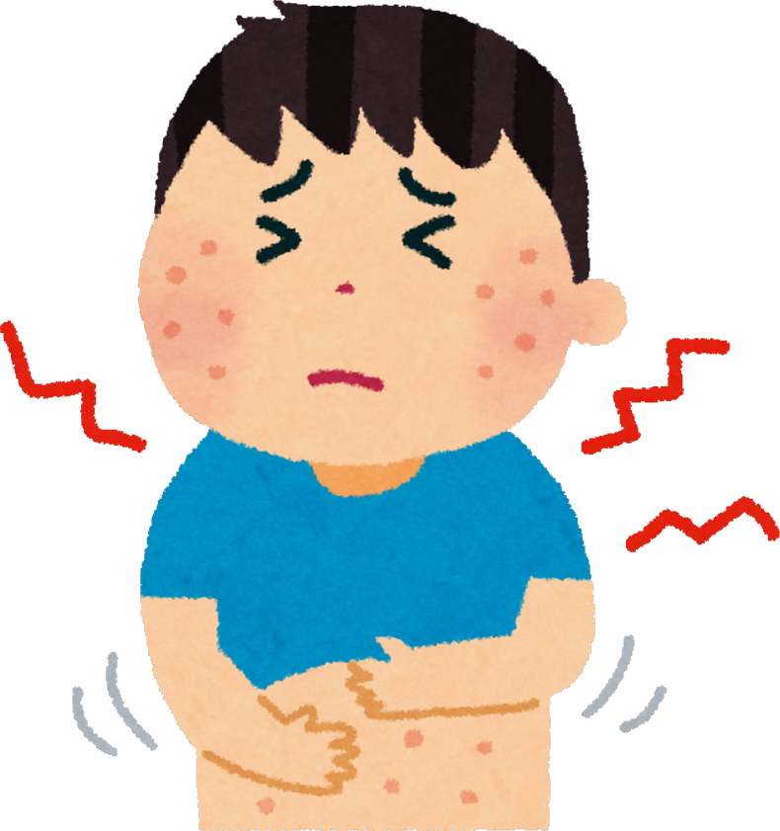
Eczema can make your skin dry, itchy, and sore

Slide 15
True

Slide 16
It can make your skin dry, itchy, and sore

Slide 17

Eczema looks the same
on everyone’s skin

Slide 18
False

Slide 19
It looks different on different people and skin tones

Slide 20

Having itchy eczema can make it hard to sleep

Slide 21
True

Slide 22
It can make it hard to sleep and make you grumpy and tired

Slide 23

Eczema can make it hard to concentrate at school

Slide 24
True

Slide 25
Itchy sore skin can make it hard to concentrate at school

Slide 26

Using creams from the doctor will make eczema go away

Slide 27
False

Slide 28
But using creams every day can make it feel better

Slide 29
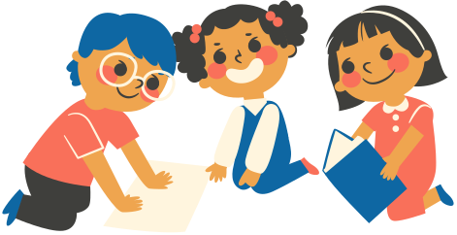
Picture Card
Activity

Slide 30
Picture Card Activity
Look at the picture cards and talk about these questions in your groups/pairs.
  What are they for?
  Why might someone with eczema need them at school?

Slide 31

Creams & Moisturisers

Slide 32
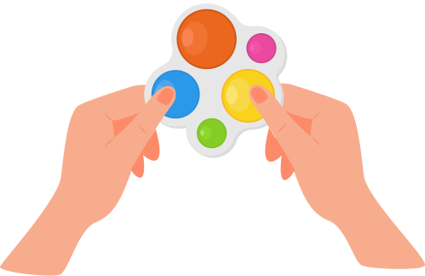

Fidget Toys

Slide 33


Special Soaps

Slide 34

Avoiding Some Foods

Slide 35

Cool Pack

Slide 36
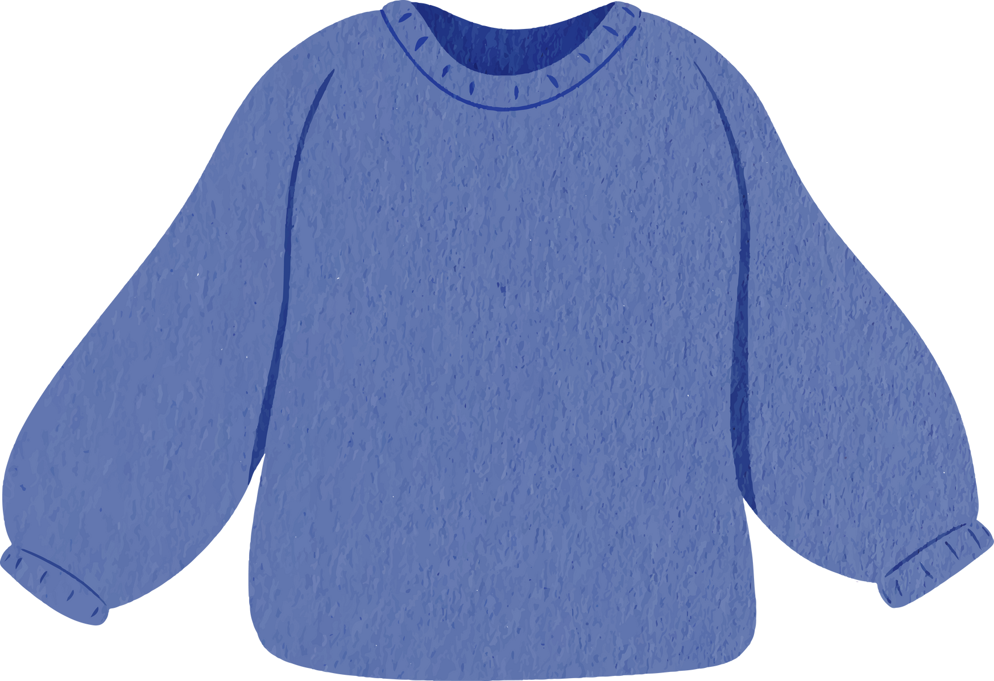
Soft Clothes

Slide 37
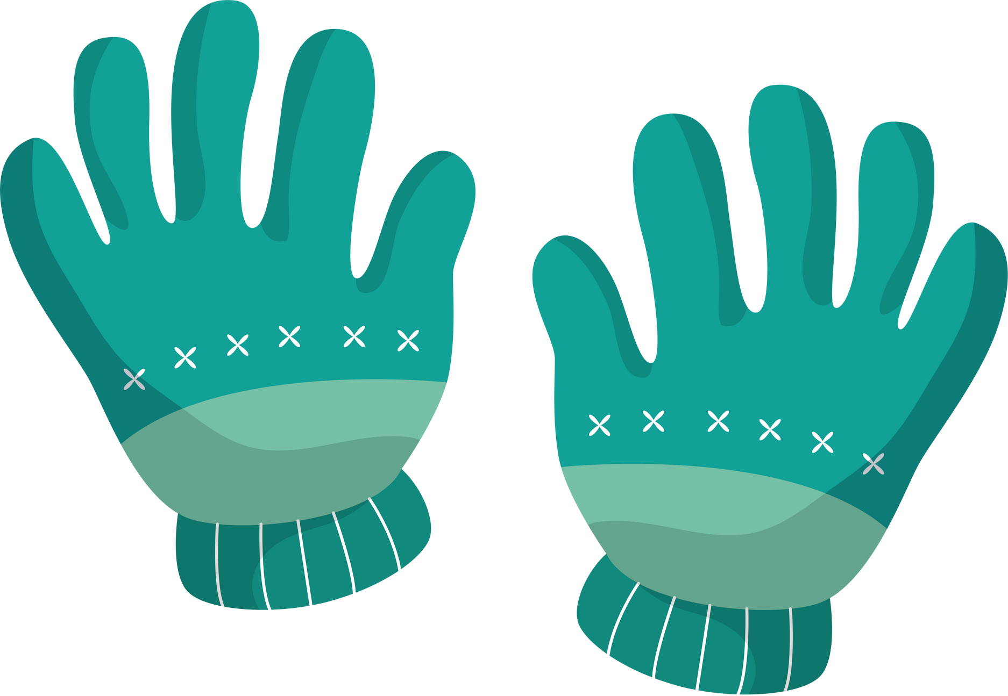
Gloves

Slide 38

Sitting on a Mat

Slide 39

Coming to School Late

Slide 40
Feeling Tired/Sleepy

Slide 41
How can we help someone who has eczema at school?

